Slide 1
Office of Small Business Programs
2025 Forecast to Industry
Carlen Capenos
Director, Office of Small Business Programs

Slide 2
Program Overview – FY25
DISA is Small Business Friendly
DISA’s Small Business First Policy:
Every requirement that comes through DISA for execution is automatically included in the Small Business Program unless and until market research demonstrates that small business cannot execute the requirement.
DISA FY26 Goals*
Small Business = 20%
Small Disadvantaged Business = 5%
Woman-Owned Small Business = 5%
Service-Disabled Veteran-Owned Small Business = 5%
HUBZone Small Business = 3%
*Anticipated
DISA SB Achievements – Last Decade
DISA FY25 Preliminary SB Achievements
Category | Total $ | Average %
SB | $15,246,734,526 | 26.8%
SDB | $7,054,799,856 | 11.58%
8(a) | $2,093,488,447 | 3.44%
WOSB | $4,557,968,048 | 7.48%
VOSB | $4,566,348,550 | 7.49%
SDVOSB | $3,454,718,615 | 5.67%
HUBZone | $1,592,456,434 | 2.61%
Category | Fed Goal | DoD Goal | DISA Goal | DISA Achievement | DISA Dollars
SB | 23% | 23.17% | 22% | 22.18% | $1.49B
SDB | 5% | 5% | 5% | 10.57% | $713.4M
WOSB | 5% | 5% | 5% | 5.75% | $385.1M
SDVOSB | 5% | 5% | 5% | 5.14% | $347.3M
HUBZone | 3% | 3% | 3% | 2.48% | $167.7M

Slide 3
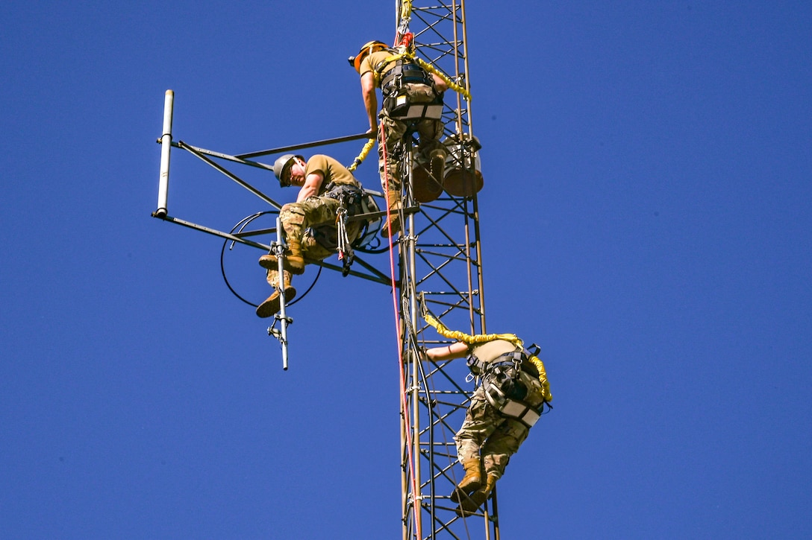
Changes: The Good, The Bad, The Unknown
  Good or Bad?
  Depends Upon Your Vantage Point…
Let’s Break Them Down…

Slide 4

Changes: Thresholds
Thresholds
New inflation-adjusted acquisition thresholds took effect on October 1, 2025
Micro-Purchase Threshold increased from $10K to $15K
SAT increased from $250K to $350K
Subcontracting Plans requirement increased from $750K to $900K
Direct Awards for 8(a)s, WOSB, HUBZone increased from $4.5M to $5.5M
Direct Awards for SDVOSB increased from $4.5M to $5M

Slide 5
Changes: SBA
SBA’s Changes Affecting DISA Procurements
Size Standards Updates:
SBA proposed increases to size standards of 263 industries
Small Business Search Revamped: (www.search.certifications.sba.gov)
Small Business Search replaces Dynamic Small Business Search
SUBNet Redesigned: (www.sba.gov/federal-contracting-guide/prime-subcontracting)
Now located on SBA’s Prime and Subcontracting page
Public can view the subcontracting opportunity postings for free with no account required
To post subcontracting opportunities, users have to re-register in the new SUBNet system

Slide 6
Changes: FAR 19
FAR Part 19 Rewrite
Big Changes:
Format – Pre-Solicitation, Evaluation and Award, Post Award
Rule of Two – sort of…
  Continues for requirements over the micro-purchase threshold
  Set asides under MACs and Federal Supply Schedules are discretionary and cannot be protested
Socioeconomic set asides are not a required consideration before small business set-aside
8(a)
  Automatic release from 8(a) program if follow-on set aside for another socioeconomic category**
  Compete first instead of direct award, even under $5.5M
Eliminated reverification of business size at order level

Slide 7

Changes: Cybersecurity
NIST Issues Cybersecurity Primer for Protecting CUI
The National Institute of Standards and Technology (NIST) recently released SP 1318: Small Business Primer for Protecting Controlled Unclassified Information (CUI), a new resource that explains in plain language how small businesses can meet the requirements of NIST SP800-171, the federal standard for safeguarding sensitive but unclassified data.
The primer breaks down what leadership, IT staff, and employees need to know, offering FAQs, examples, and step-by-step starting points that make compliance more achievable.
https://csrc.nist.gov/pubs/sp/1318/final

Slide 8

What Hasn’t Changed
DISA Small Business First Policy
DISA 101 Small Business Orientations
DISA OSBP Email Distribution List
DISA Forecast updated quarterly on www.disa.mil
DISA Acquisition Decision Document updated monthly on www.disa.mil
DISA Office of Small Business Programs Staff

Slide 9

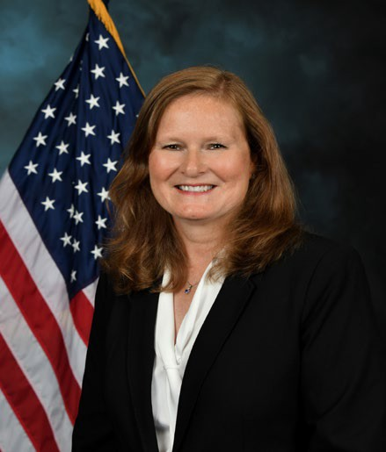

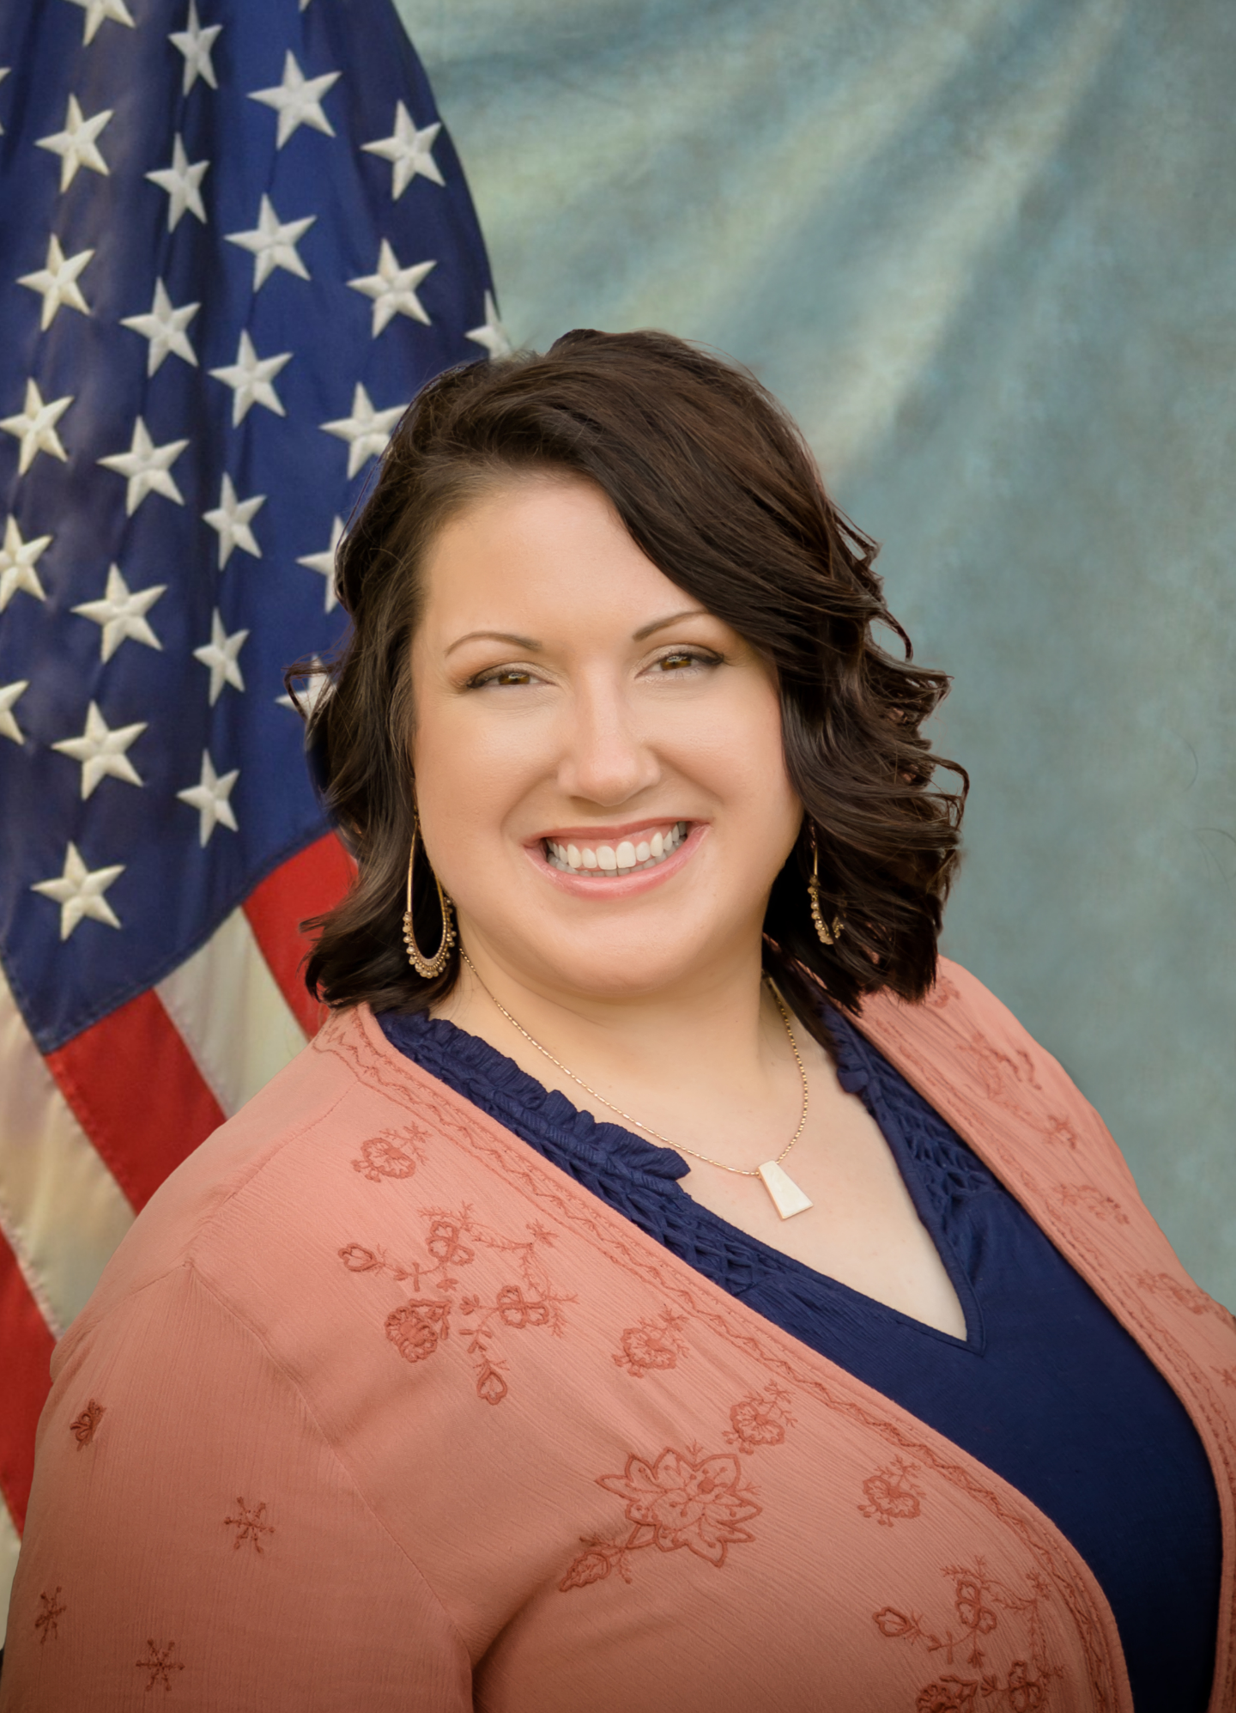
Office of Small Business Programs
Carlen Capenos Director
Christie Stukenberg
Small Business Professional
Jessica L. Bathon-Logsdon
Small Business Professional
MISSION: We serve as the principal advocate for small businesses and primary advisor to DISA for the small business program
VISION: To educate small businesses and to advocate for maximum small business opportunities to support DISA in serving and protecting the warfighter in cyberspace

Slide 10

Questions:
DISASmallBusiness@mail.mil

Slide 11
